Slide 1
Ideation Workshop
Adapted from: The University of Copenhagen
https://innovationenglish.sites.ku.dk/metode/clustering/

Slide 2
Your Challenge
Write down your challenge and the preconditions from the International Partner
Think about: What is the potential of the solution to the challenge (what can be gained? And for whom?)

Slide 3
Opportunity Analysis
Identify areas of opportunities for new innovative solutions in relation to your challenge which will be used for brainstorming.

Slide 4
Brainstorming Rules
Go for quantity Always say yes!
Don´t judge (there is plenty of time for that later)
Format: Write one idea down on each post-it or textbox (if you’re working virtual)
Name your ideas
Draw illustrations or provide images if possible

Slide 5
Brainstorm 1: By Yourself
Generate as many ideas as possible - at least 10!

Slide 6
Brainstorm 2: In Your Team
Look at the ideas in your group
Can you combine some of the ideas?
Brainstorm on new ideas – at least 50

Slide 7
Clustering
Categorize your ideas into themes and name them accordingly
Keep organizing until you find appropriate clusters of ideas

Slide 8
Evaluation and Selection
What are your team’s criteria to the solution you are to develop?
Write these down (at least 5 criteria)

Slide 9
Dot Voting
Each group member gets a total of 10 votes
Mark the favorite ideas with a dot, keeping in mind your selection criteria
Select 10 ideas with most dots to take further in the process

Slide 10
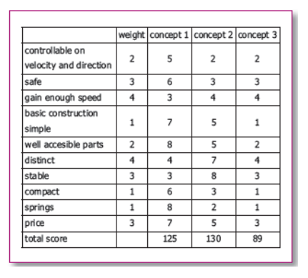
Weighted Idea Selection
Rate your criteria from 1-10, where 10 is the highest score
Give every idea points based on the criteria
Calculate total scores for each idea
Select the top 3 ideas with most points (?)

Slide 11
Concepts
Name your concepts
Describe the product/process
Who are the customers and end-users?
Can you describe the user experience? – E.g.: Sensoric, interaction, situations, associations/storytelling, health benefits – => Value creation? ?
What kind of innovation is it (potentially)?

