Slide 1

Reflective Assessments
Reflective assessments are valuable for promoting self-awareness, critical thinking, and personal growth.
The key to effective reflective assessments is providing prompts or questions that encourage deep thought and introspection while allowing individuals the freedom to express themselves authentically.

Slide 2
Types of Reflective Assessments
Diagnostic & Summative self-checks
Written Reflections
Self-Assessment Survey
Case Studies
Personal Development plans
Notes:
Diagnostic self-checks are assessments that occur at the beginning of a learning process or a new lesson or topic. They are designed to help learners gauge their current knowledge, skills, and understanding related to the subject matter. (concept quizzes, self-assessment surveys at the start of the lesson).
Summative self-checks, on the other hand, occur at the end of a learning period, unit, or course. They are intended to evaluate the overall learning and to determine whether the learner has achieved the desired learning outcomes. (End-of-lesson knowledge check quizzes/multiple choice/matching- where answered are provided automatically or self-assessment rubrics completed at the conclusion of a course or project)
Written Reflections: Participants are asked to keep a journal or write reflective comments about their experiences, thoughts, feelings, or personal growth. These writings are often open-ended and can cover a wide range of topics.
Self-Assessment Surveys: Participants may complete self-assessment surveys or questionnaires that ask them to evaluate their own skills, attitudes, or behaviors. These surveys can prompt individuals to reflect on their strengths, weaknesses, and areas for improvement.
Case Studies: individuals may analyze case studies or real-life scenarios and provide reflective analyses of the situation, exploring what they've learned and how it applies to their own experiences.
Personal Development Plans: In professional development or personal growth settings, individuals may create personal development plans that include goals, strategies, and reflections on their progress toward those goals.

Slide 3
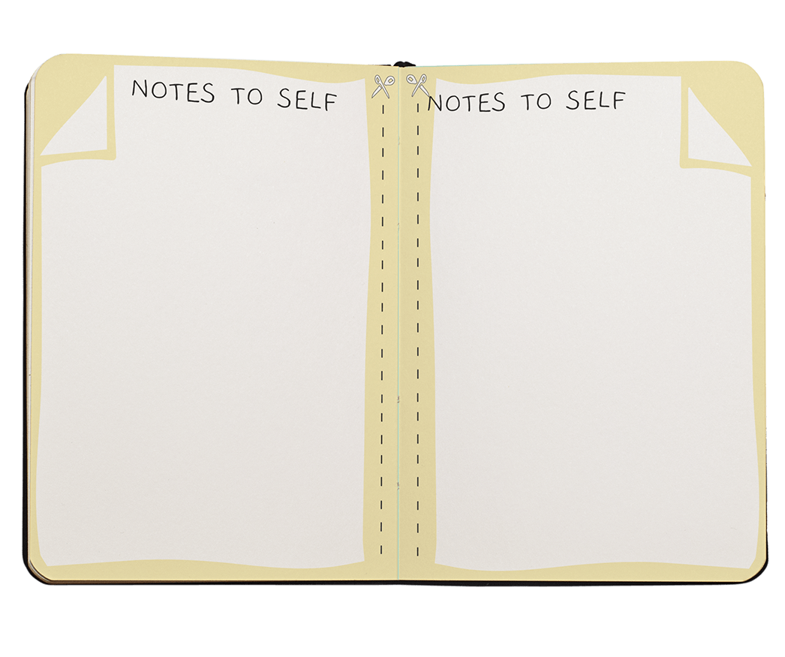
Thought Book
In an academic or professional context, a "thought book" could be a notebook where someone keeps notes, observations, and reflections related to their work or studies. It might contain research notes, project ideas, or reflections on meetings and discussions.
You could provide guidance and prompts for them to:
set actionable learning goals
reflect on and chart their learning progress
Notes:
Use reflection to help students decipher their own learning needs and engage in deep, thought-provoking discourse about progress.
Could take the form of sketch notes

Slide 4




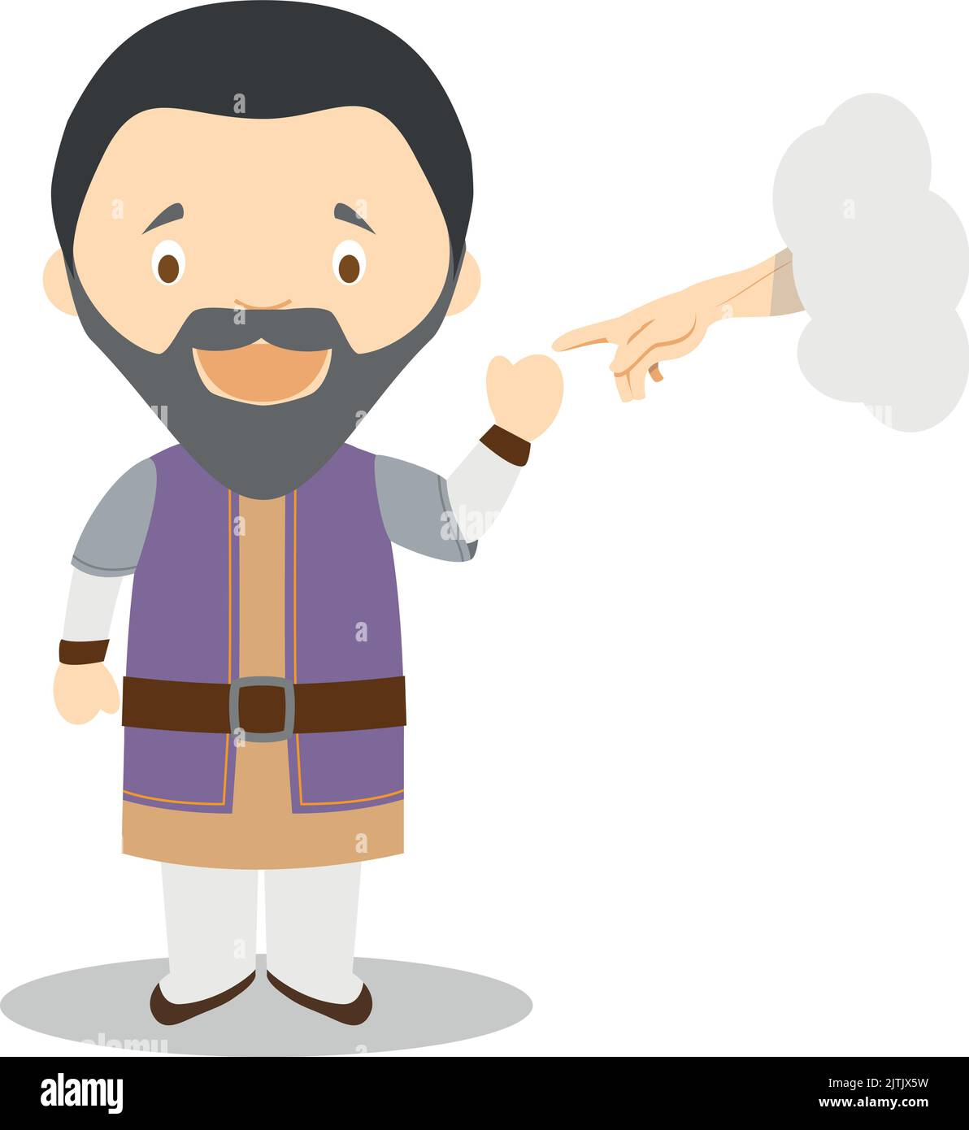
Virginia Woolf kept written journals for decades in which she developed and tested her literary ideas and techniques
Leonard da Vinci, who, while best remembered for his art, also recorded many designs for a wide variety of inventions he imagined
Kurt Cobain recorded evolving song lyrics accompanied by sketches for his band, Nirvana
Frida Kahlo recorded her developing thinking about her art in journals that included drawings and coloured sketches as well as text.
Michelangelo made repeated sketches, some even drawn on the walls of buildings where he worked, that became the basis for his frescoes and sculptures
Notes:
Leonard da Vinci, who, while best remembered for his art, also recorded many designs for a wide variety of inventions he imagined. Ք Virginia Woolf kept written journals for decades in which she developed and tested her literary ideas and techniques. Ք Michelangelo made repeated sketches, some even drawn on the walls of buildings where he worked, that became the basis for his frescoes and sculptures. Ք Frida Kahlo recorded her developing thinking about her art in journals that included drawings and coloured sketches as well as text. Ք Kurt Cobain recorded evolving song lyrics accompanied by sketches for his band, Nirvana.
The individuals mentioned above used journals and other media in a lifelong process of creative thinking, in a classroom a Thoughtbook is best used to allow students to explore a defined inquiry using a similar iterative process

Slide 5
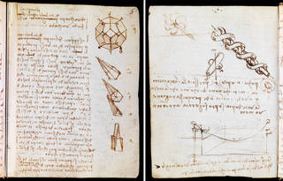

Slide 6
Thought Prompt Examples
Could you identify one or two specific goals and targets (SDG indicators) your course could work towards?
How can you adapt methods of instruction for student engagement in sustainable development?
How will the strategies you use to adapt a Level 1 implementation of Interdisciplinary Project Based Learning relate to real-world situations and problems?
Is the space/experience being created through AR/VR and MR authentically inviting to all? Does the space/experience reflect a wide range of learning needs and opportunities? Can the students change and adapt the space/experience to meet their evolving learning needs?

